Slide 1
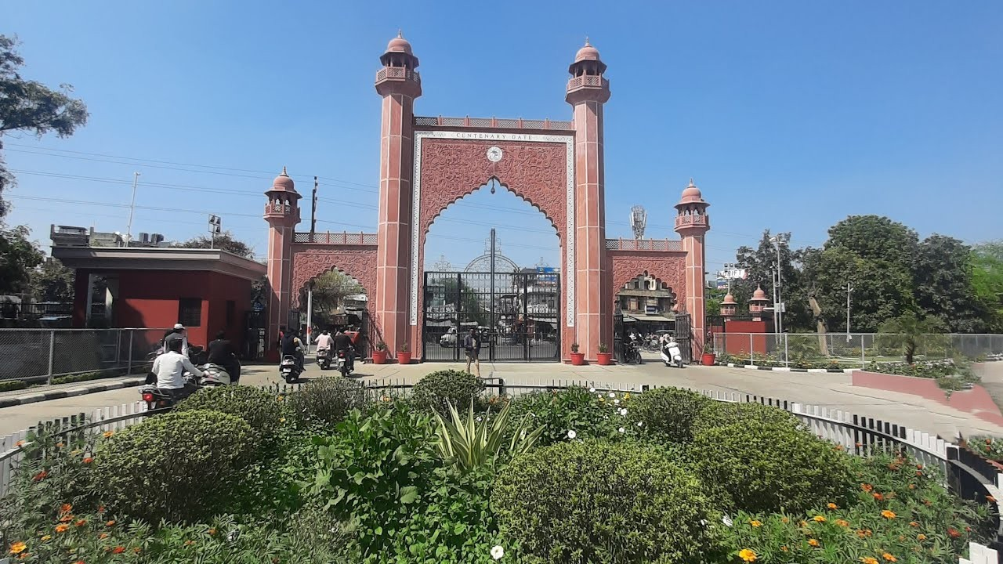
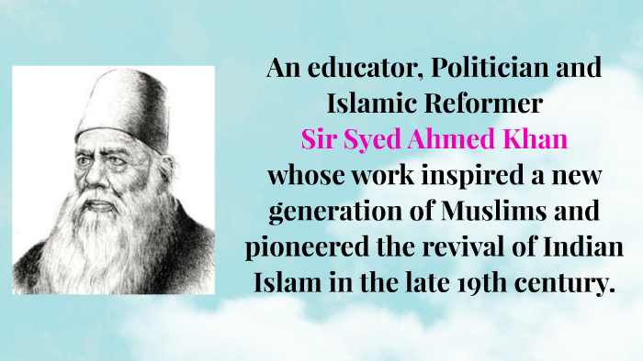
Sir Syed’s Legacy
Aligarh Muslim University

